Slide 1
Automata Theory
Lecture # 3
Languages-II

Slide 2
Formal Language
A formal language is a set of words—that is, strings of symbols drawn from a common alphabet.
The word "formal” refers to the fact that all the rules for the language are explicitly stated in terms of what strings of symbols can occur.
Language will be considered solely as symbols on paper and not as expressions of ideas in the minds of humans. The term "formal" used here emphasizes that it is the form of the string of symbols we are interested in, not the meaning.

Slide 3
Descriptive definition of Languages
The language is defined, describing the conditions imposed on its words.
Example: The language L of strings of odd length, defined over Σ={a}, can be written as
L={a, aaa, aaaaa,…..}
Example: The language L of strings that does not start with a, defined over Σ ={a,b,c}, can be written as
L ={Λ, b, c, ba, bb, bc, ca, cb, cc, …}

Slide 4
Descriptive definition of Languages
Example:The language L of strings of length 2, defined over Σ ={0,1,2}, can be written as
L={00, 01, 02,10, 11,12,20,21,22}
Example: The language L of strings ending in 0, defined over Σ ={0,1}, can be written as
L={0,00,10,000,010,100,110,…}
Example:The language EQUAL, of strings with number of a’s equal to the number of b’s, defined over Σ={a,b}, can be written as
{Λ , ab, aabb, abab, baba, abba,…}

Slide 5
Example: The language EVEN-EVEN, of strings with even number of a’s and even number of b’s, defined over Σ={a,b}, can be written as
{Λ, aa, bb, aaaa, aabb, abab, abba, baab, baba, bbaa, bbbb,…}
Example: The language INTEGER, of strings defined over Σ={-,0,1,2,3,4,5,6,7,8,9}, can be written as
INTEGER = {…,-2,-1,0,1,2,…}

Slide 6
Example: The language {a^{n}b^{n} }, of strings defined over Σ={a,b}, as
{a^{n} b^{n} : n=1,2,3,…}, can be written as
{ab, aabb, aaabbb,aaaabbbb,…}
Example:
The language {a^{n}b^{n}a^{n} }, of strings defined over Σ={a,b}, as
{a^{n} b^{n} a^{n}: n=1,2,3,…}, can be written as
{aba, aabbaa, aaabbbaaa,aaaabbbbaaaa,…}

Slide 7
Example: The language factorial, of strings defined over Σ={0,1,2,3,4,5,6,7,8,9} i.e.
{1,2,6,24,120,…}
Example:
The language FACTORIAL, of strings defined over Σ={a}, as
{a^{n!} : n=1,2,3,…}, can be written as
{a,aa,aaaaaa,…}. It is to be noted that the language FACTORIAL can be defined over any single letter alphabet.

Slide 8
Example:
The language DOUBLEFACTORIAL, of strings defined over Σ={a, b}, as
{a^{n!}b^{n!} : n=1,2,3,…}, can be written as
{ab, aabb, aaaaaabbbbbb,…}
Example:
The language SQUARE, of strings defined over Σ={a}, as
{ : n=1,2,3,…}, can be written as
{a, aaaa, aaaaaaaaa,…}

Slide 9
PALINDROME
The language consisting of Λ and the strings s defined over Σ such that Rev(s)=s.
It is to be noted that the words of PALINDROME are called palindromes.
Example: For Σ={a,b},
PALINDROME={Λ , a, b, aa, bb, aaa, aba, bab, bbb, ...}
Remark: There are as many palindromes of length 2n as there are of length 2n-1.

Slide 10
Regular Expressions (REs)
Any language-defining symbols generated according to some rule are called regular expressions OR a regular expression is a pattern describing a certain amount of text OR
A regular expression represents a "pattern“; strings that match the pattern are in the language, strings that do not match the pattern are not in the language.
Regular expressions describe regular languages.

Slide 11
Regular Expressions
Example:
describes the language
Example:
describes the language
Example:
Not a regular expression:

Slide 12
REs
Here instead of applying Kleene Star Operation (KSO) over some set S, we shall straight away apply KSO on some alphabet say “a” and write it as “a*” which means
a* = λ, a, aa, aaa, …….
And Kleene plus closure is
a⁺ = a, aa, aaa, …….
Where a⁺ = aa*
a* = λ + a⁺

Slide 13
Operators allowed in REs
Every RE can contains concatenation “dot” operator, + i.e. logical operator “or”, Kleene Star Closure, Kleene Plus Closure and parenthesis only.
Precedence of Operators:
The Kleene Star (or Kleene Plus) operator has highest precedence.
Next come the precedence of concatenation or “dot” operator.
The union or + operator has the lowest priority.

Slide 14
Primitive REs
Primitive regular expressions:
Thus, if |Σ| = n, then there are n+2 primitive regular expressions defined over Σ .
Given regular expressions and
Are regular expressions

Slide 15
Languages of Regular Expressions
: language of regular expression
Example:
The languages defined by the primitive regular expressions are:
(i) The primitive regular expression φ denotes the language {}. There are no strings in this language.
(ii) The primitive regular expression λ denotes the language {λ}. The only string in this language is the empty string or the string with no letters.
(iii) For each x ∈ Σ , the primitive regular expression x denotes the language {x} i.e. the only string in the language is the string "x".

Slide 16
Note: The language φ is the language with no words and for REs, the φ is the regular expression for the null language.
If r and φ are REs then
r + φ = r
and φr = φ
1- {a}.{ϵ}={a}
2- {a}. ∅=∅ :L(ϕ)={}
3- {a} . {λ} = a

Slide 17
Languages of Regular Expressions
Example: Consider the alphabet Σ={a}
The language of all words containing even number of a’s can be defined by the following RE (aa)*
Example: Language of all words containing only odd no. of a’s can be defined by the following RE
1. (aaa)* 2. a(aa)*+λ 3. a+(aa)* 4. a⁺a*
5. a+(aa)*a correct but inefficient due to repetition
6. (aa)*a or a(aa)* correct

Slide 18
Languages of Regular Expressions
Example: The language of all words having all possible combinations of a’s followed by one b can be described by the following RE.
1. a+b 2. a*+b 3. a*b 4. (λ+a⁺)b 5. a⁺b+b
Example: The language of all words in which all a’s (if any) comes before all the b’s (if any) can be defined the following RE
(ab)* 2. a*b*
3. a+b+a⁺b⁺+λ 4. b+a⁺b*+λ both are inefficient

Slide 19
Example:The language of all words of a’s & b’s that have atleast two letters, that begin & end with a’s & that have nothing but b’s inside (if any thing at all) can be defined by following RE.
Σ = {a, b}
(aba)* 2. ab*a⁺ 3. ab⁺a 4. a⁺b*a⁺
5. ab*a

Slide 20
Example: Consider the alphabet Σ={a,b,c}. The language of all words that begins with either a or c, followed be any no. of b’s can be defined by following RE.
(a+c)b* = ab* + cb*
Example: The language of all words that ends with letter b can be defined by the following RE
(a+b)*b

Slide 21
Example: The language of all words that have at least 1 a in them somewhere can be defined be by RE
(a+b)*a(a+b)*
Example:The language of all words that have at least 2 a’s in them somewhere.
(a+b)*a(a+b)*a(a+b)* OR
b*ab*a(a+b)* OR
b*a(a+b)*ab* OR
(a+b)*ab*ab*

Slide 22
Example: The language of all words that have exactly 2 a’s in them somewhere can be defined by RE
b*ab*ab*
Example: The language of all words that have at most one a in them somewhere can be defined by RE
b*(a+λ)b* OR
b*ab* + b*

Slide 23
Example: The language of all words having at least one a and one b, may be expressed by the following RE
(a+b)*a(a+b)*b(a+b)* + (a+b)*b(a+b)*a(a+b)*
Example: The language of all words starting with a and ending in b or starting with b and ending in a, may be expressed by the following RE
a(a+b)*b + b(a+b)*a

Slide 24
Example: The language of all strings that at some point contain a double letter, may be expressed by the following RE
(a + b)*(aa + bb)(a + b)*
Example: The language of all strings that do not contain a double letter, may be expressed by the following RE
(λ + b) (ab)*(λ + a)

Slide 25
Definition
For regular expressions and

Slide 26
Example
Regular expression:

Slide 27
Example
Regular expression
Regular expression

Slide 28
Example
= { all strings with at least
two consecutive 0 }
= { all strings without
two consecutive 0 }

Slide 29
Finite Automaton
Finite automata are computing devices that accept/recognize regular languages and are used to model operations of many systems we find in practice.
In the word ‘Finite Automata’, Finite means the no. of letters in the input alphabet & the no. of states are both finite and automata means automatic.

Slide 30
Finite Automaton
(also called acceptor/recognizer)
A Finite Automaton (FA) is a collection of three things
Finite set of input letter Σ from which input strings are formed.
Finite number of states, having one initial and some (maybe none) final states.
Finite set of transitions i.e. for each state and for each input letter there is a transition showing how to move from one state to another.

Slide 31
Finite Automaton
Input
String
Output
Finite
Automaton
String

Slide 32
Finite Accepter
Input
String
Output
“Accept”
or
“Reject”
Finite
Automaton

Slide 33
FA - Examples
Example:
Σ = {a,b}
States: x, y, z where x is an initial state and z is final state.
Transitions:
At state x reading a, go to state z
At state x reading b, go to state y
At state y reading a, b go to state y
At state z reading a, b go to state z

Slide 34
Example:
State Transition Table
The FA is
(Transition Diagram)
RE : ?
Old States | New States
 | Reading a | Reading b
x - | z | y
y | y | y
z + | z | z
a(a+b)*

Slide 35
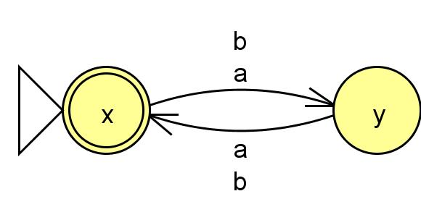
FA
State Transition Table ? Over same Σ
Regular Expression?

Slide 36
Formalities
Deterministic Finite Accepter (DFA) OR Deterministic Finite Automaton
: set of states
: input alphabet
: transition function
: initial state
: set of final states

Slide 37
Write R.E: It accepts at least one b somewhere in the strings
RE :
(a+b)*b(a+b)* or a*b(a+b)*

Slide 38
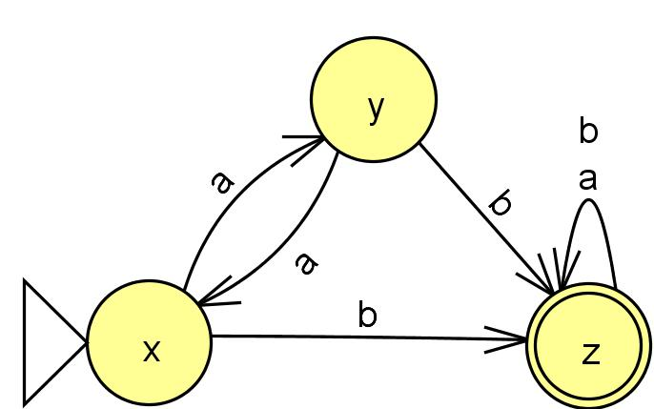
State Transition Table
Old States | New States
 | Reading a | Reading b
x - | y | z
y | x | z
z + | z | z

Slide 39
Ex: The FA that accepts the language with RE = (a+b)*(aa+bb)(a+b)*
Ex: The FA that accepts the language with all the strings having at least one triple letter.
Ex: The FA that accepts the language of all the words that
Have b as the 2nd letter
Have b as the 3rd letter

Slide 40
Note: there are FAs that accept no language. These are of two types
FA’s that have no final state, such as
(ii) FA’s in which final states cannot be reached from the start state i.e. a disconnected graph or graph like this

Slide 41
Ex. The FA that accepts the language with all the strings that do not end with a.
Sol. Do not ends with a = Ends with what?
OR
take the complement of “ends with a”.
Ex-p-68. The language of all the words that have different first and last letter.
Ex-p-65. The FA that accepts only the words baa and ab.
Ex. The FA that accepts only the words baa, ba and ab.

Slide 42
Ex-p-65: What language the following FA accepts i.e. find RE.

Slide 43
Ex-p-65: What language the following FA accepts i.e. find RE.

Slide 44
Ex: FA for all strings having less than 3 b’s.
Ex: FA for EVEN-EVEN language
RE = (aa+bb+(ab+ba)(aa+bb)*(ab+ba))*
Q.4. (i) Build an FA with three states that accepts all strings.
Q.6. FA that accepts only those word that do no end with ba.
Sol: Do no end with ba = Ends with what?
OR Find FA that ends with ba then take complement.

Slide 45
Q.7: (i) Begin or end with double letter.
(ii) Begin and end with double letter.
Sol: Find FA that begin with double letter
Find FA that end with double letter
Now combine the above two FAs. To find the solution of both the parts.
Q.8: Even number of substring ab
Q.9: (i) FA that accepts the language of all the strings that have both the letter a and the letter b in them, but not necessarily in that order.
(ii) All the strings that have onl a’s or only b’s in them

Slide 46
Important Notes
If λ is present in the language we can make the FA accept λ by making the start state as the final state.
From every state there will be as many outgoing arrows → as there are letters in the alphabet.
If any RE contains (a+b)* in the beginning we shall first construct the FA by discarding that (a+b)*, the initially discarded (a+b)* will be taken into account by missing arrows & there will be no dead end state.
When all the words of the language (finite) are accepted by the FA then all the missing edges will go to dead end state.

